Slide 1
Online Shopping Application

Slide 2
Technologies
Java 8
Spring Boot
Spring Security
Angular | React
PostgreSQL | MYSQL
Maven | Gradle

Slide 3
Problem Statement
This application is used by ABC Company admin and their Customer for online shopping
This application will help Customer to buy the products and view order details.
Customer can register themselves and login. Add product to the cart and purchase it .
This application will help Admin to search Product list ,add new products ,remove products and update product .

Slide 4
Plan
Design
Generate the skeleton as per class design provided
TDD approach
Identify test cases for each module
Write Failing Test cases
Convert the Test Cases in GREEN
Implement the case study in incremental manner

Slide 5
Modules
Login Module
Customer Module
Product Module
Order Module
Cart
Module

Slide 6
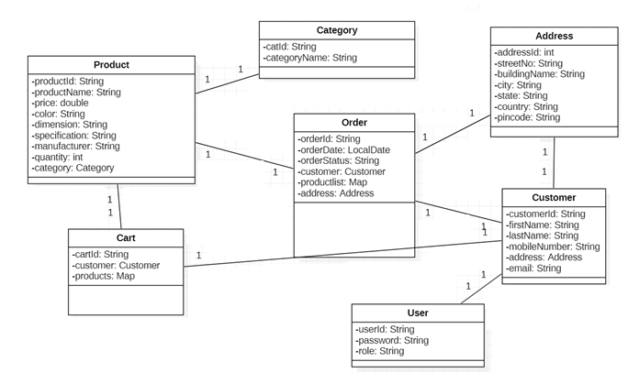
Class Design [POJO Classes]

Slide 7
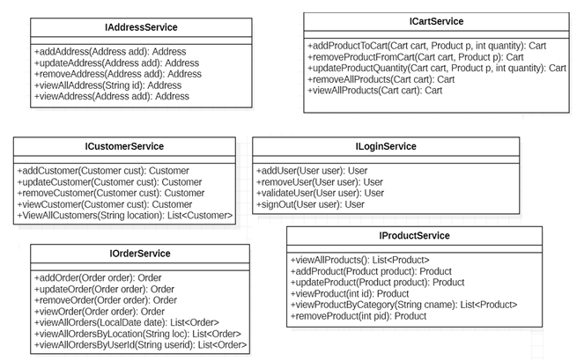
Class Design [Service Interface]

Slide 8
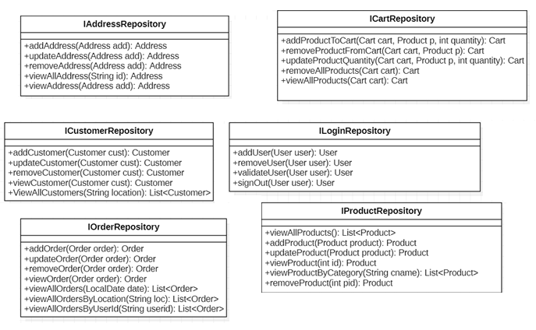
Class Design [Repository]

